Slide 1
The conceptual differences between the two systems are based on how these systems keep a secret.
In symmetric-key cryptography, the secret must be shared between two persons.
In asymmetric-key cryptography, the secret is personal (unshared); each person creates and keeps his or her own secret.
In a community of n people, n(n − 1)/2 shared secrets are needed for symmetric-key cryptography;
Only n personal secrets are needed in asymmetric-key cryptography.
.

Slide 2
Symmetric-key cryptography is based on sharing secrecy;
asymmetric-key cryptography is based on personal secrecy.
.

Slide 3
In symmetric-key cryptography, the plaintext and ciphertext are thought of as a combination of symbols.
Encryption and decryption permute these symbols or substitute a symbol for another.
In asymmetric-key cryptography, the plaintext and ciphertext are numbers;
encryption and decryption are mathematical functions that are applied to numbers to create other numbers.
.

Slide 4
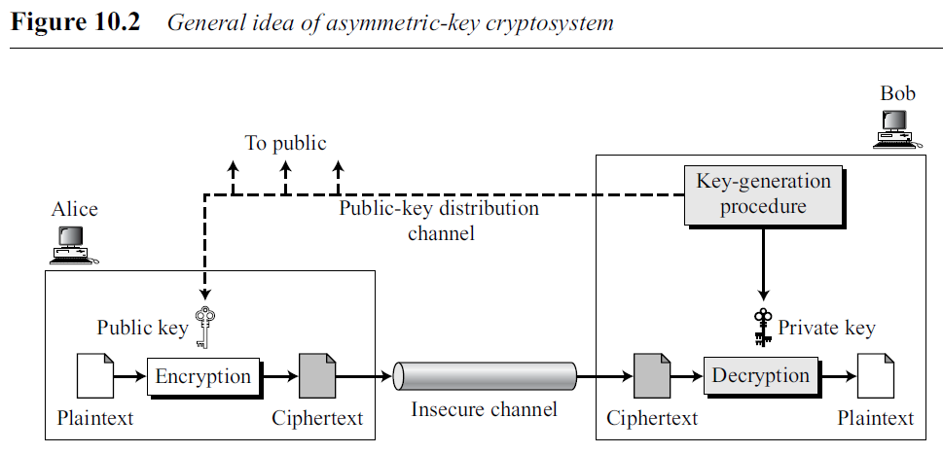
General Idea
General idea of asymmetric-key cryptography as used for encipherment.
There are distinctive keys in asymmetric-key cryptography: a private key and a public key.
.

Slide 5
Figure 10.2 shows several important facts.
First, it emphasizes the asymmetric nature of the cryptosystem. Bob needs to create two keys: one private and one public. Bob is responsible for distributing the public key to the community. This can be done through a public-key distribution channel.
Second, asymmetric-key cryptography means that Bob and Alice cannot use the same set of keys for two-way communication.
Each entity in the community should create its own private and public keys.
Third, asymmetric-key cryptography means that Bob needs only one private key to receive all correspondence from anyone in the community, but Alice needs n public keys to communicate with n entities in the community, one public key for each entity.
.

Slide 6
Plaintext/Ciphertext
Unlike in symmetric-key cryptography, plaintext and ciphertext are treated as integers in asymmetric-key cryptography.
The message must be encoded as an integer (or a set of integers) before encryption;
the integer (or the set of integers) must be decoded into the message after decryption.
.

Slide 7
Encryption/Decryption
Encryption and decryption in asymmetric-key cryptography are mathematical functions applied over the numbers representing the plaintext and ciphertext.
ciphertext C = f (Kpublic, P);
plaintext P = g(Kprivate, C).
function f is used only for encryption;
function g is used only for decryption.
function f needs to be a trapdoor one-way function to allow Bob to decrypt the message but to prevent Eve from doing so.
.

Slide 8
Need for Both
The advent of asymmetric key (public-key) cryptography does not eliminate the need for symmetric-key (secretkey) cryptography.
Asymmetric-key cryptography, which uses mathematical functions for encryption and decryption, is much slower than symmetric-key cryptography.
For encipherment of large messages, symmetric-key cryptography is still needed.
Speed of symmetric-key cryptography does not eliminate the need for asymmetric-key cryptography.
Asymmetric-key cryptography is still needed for authentication, digital signatures, and secret-key exchanges.
.

Slide 9
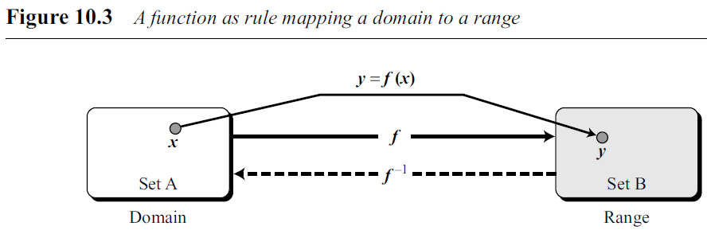
Trapdoor One-Way Function
Main idea behind asymmetric-key cryptography is the concept of the trapdoor oneway function.
Functions
A function is a rule that associates (maps) one element in set A, called the domain, to one element in set B.
An invertible function is a function that associates each element in the range with exactly one element in the domain.
.

Slide 10
One-Way Function
A one-way function (OWF) is a function that satisfies the following two properties:
1. f is easy to compute. In other words, given x, y = f (x) can be easily computed.
2. f⁻¹ is difficult to compute. In other words, given y, it is computationally infeasible to calculate x = f⁻¹(y).
.

Slide 11
One-Way Function
Example 10.1
When n is large, n = p × q is a one-way function.
function x is a tuple (p, q) of two primes and y is n.
Given p and q, it is always easy to calculate n; given n, it is very difficult to compute p and q.
This is the factorization problem. There is not a polynomial time solution to the f⁻¹ function in this case.
.

Slide 12
One-Way Function
Example 10.2
When n is large, the function y = x^{k} mod n is a trapdoor one-way function.
Given x, k, and n, it is easy to calculate y using the fast exponential algorithm.
Given y, k, and n, it is very difficult to calculate x. This is the discrete logarithm problem.
There is not a polynomial time solution to the f⁻¹ function in this case.
However, if we know the trapdoor, k′ such that k × k′ = 1 mod φ(n), we can use x = y^{k′} mod n to find x. This is the famous RSA.
.

Slide 13
10.2 RSA CRYPTOSYSTEM
The most common public-key algorithm is the RSA cryptosystem, named for its inventors (Ron Rivest, Adi Shamir, and Leonard Adleman).
RSA uses two exponents, e and d, where e is public and d is private.
Suppose P is the plaintext and C is the ciphertext.
Alice uses C = P^{e} mod n to create ciphertext C from plaintext P;
Bob uses P = C^{d} mod n to retrieve the plaintext sent by Alice.
n is very large number, is created during the key generation process.
.

Slide 14
10.2 RSA CRYPTOSYSTEM
Encryption and decryption use modular exponentiation.
Modular exponentiation is feasible in polynomial time using the fast exponentiation algorithm.
However, modular logarithm is as hard as factoring the modulus, for which there is no polynomial algorithm yet.
.

Slide 15
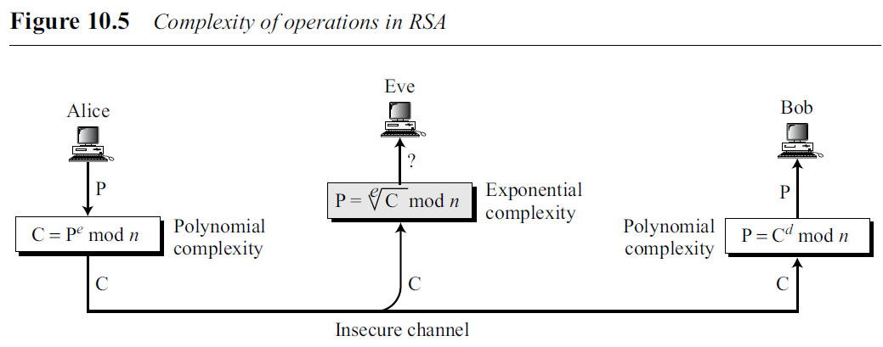
10.2 RSA CRYPTOSYSTEM
This means that Alice can encrypt in polynomial time (e is public), Bob also can decrypt in polynomial time (because he knows d), but Eve cannot decrypt because she would have to calculate the e^{th} root of C using modular arithmetic.
.

Slide 16
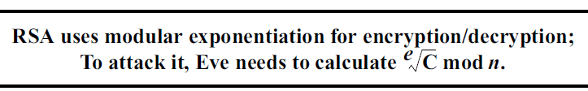
10.2 RSA CRYPTOSYSTEM
In other words, Alice uses a one-way function (modular exponentiation) with a
trapdoor known only to Bob.
Eve, who does not know the trapdoor, cannot decrypt the message.
If some day, a polynomial algorithm for eth root modulo n calculation is found, modular exponentiation is not a one-way function any more.
.

Slide 17
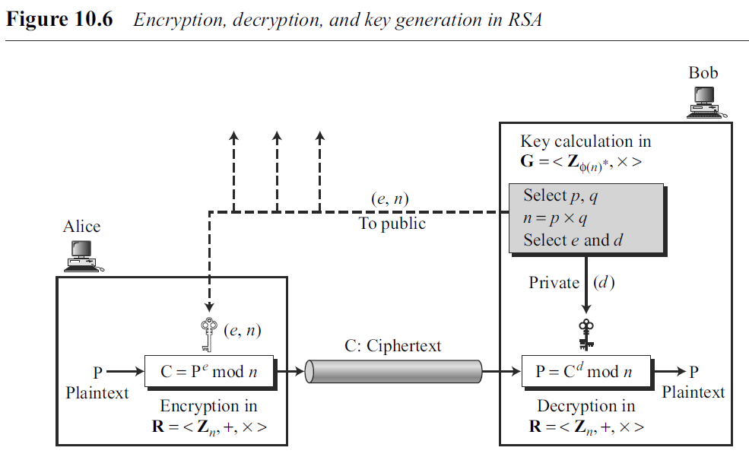
Procedure
general idea behind the procedure used in RSA.
.

Slide 18
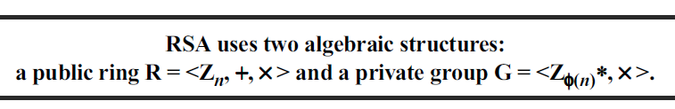
Procedure
Two Algebraic Structures
RSA uses two algebraic structures: a ring and a group.
Encryption/Decryption Ring Encryption and decryption are done using the commutative ring R = <Z_{n}, +, × > with two arithmetic operations: addition and multiplication.
Key-Generation Group RSA uses a multiplicative group G = <Z_{φ(n)}∗, × > for
key generation. This group supports only multiplication and division (using multiplicative inverses), which are needed for generating public and private keys.
.

Slide 19
Procedure
Key Generation
Bob uses the steps shown in Algorithm 10.2 to create his public and private key.
After key generation, Bob announces the tuple (e, n) as his public key; Bob keeps the integer d as his private key.
Bob can discard p, q, and φ(n); they will not be needed unless Bob needs to change his private key without changing the modulus (not recommended).
Recommended size for each prime, p or q, is 512 bits (almost 154 decimal digits). This makes the size of n, the modulus, 1024 bits (309 digits).
.

Slide 20
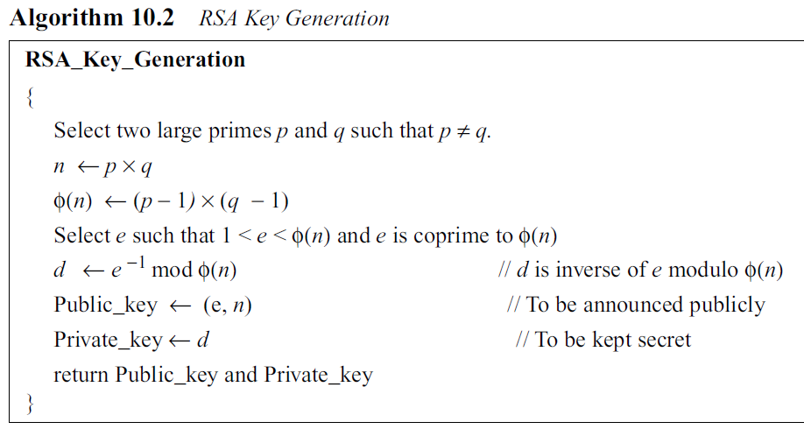
Procedure
Key Generation
φ(n) : Euler's totient function Co-prime: no common factors other than 1
.

Slide 21
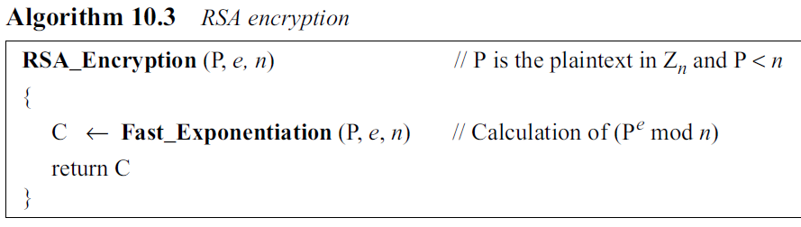
Procedure
Encryption
Anyone can send a message to Bob using his public key.
The size of the plaintext must be less than n, which means that if the size of the plaintext is larger than n, it should be divided into blocks.
.

Slide 22
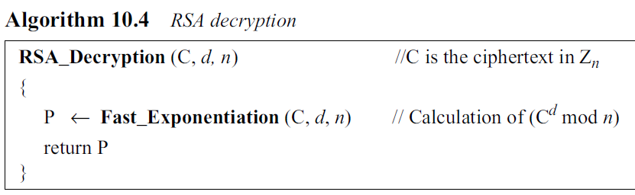
Procedure
Decryption
The size of the ciphertext is less than n.
.

Slide 23

Procedure
.

Slide 24
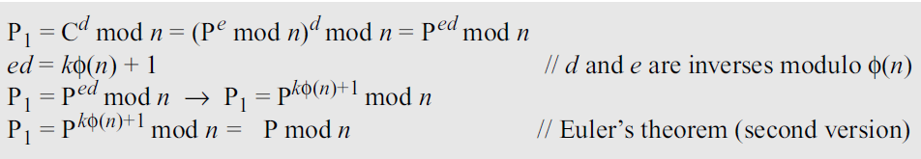
Proof of RSA
We can prove that encryption and decryption are inverses of each other using the second version of Euler’s theorem.
Assume that the plaintext retrieved by Bob is P1 and prove that it is equal to P.
.

Slide 25
Some Trivial Examples
Example 10.5
Bob chooses 7 and 11 as p and q and calculates n = 7×11 = 77.
The value of φ(n) = (7 − 1)(11 − 1) or 60.
Now he chooses two exponents, e and d
If he chooses e to be 13, then d is 37.
Note that e × d mod 60 = 1 (they are inverses of each other).
Now imagine that Alice wants to send the plaintext 5 to Bob. She uses the public exponent 13 to encrypt 5.
.

Slide 26
Some Trivial Examples
Bob receives the ciphertext 26 and uses the private key 37 to decipher the ciphertext:
The plaintext 5 sent by Alice is received as plaintext 5 by Bob.
.

Slide 27
Some Trivial Examples
Example 10.6
Now assume that another person, John, wants to send a message to Bob.
John can use the same public key announced by Bob (probably on his website), 13; John’s plaintext is 63. John calculates the following:
Bob receives the ciphertext 28 and uses his private key 37 to decipher the ciphertext
.

Slide 28
Some Trivial Examples
Example 10.7
Jennifer creates a pair of keys for herself. She chooses p = 397 and q = 401.
She calculates n = 397 × 401= 159197.
She then calculates φ(n) = 396 × 400 = 158400.
She then chooses e = 343 and d = 12007.
Show how Ted can send a message to Jennifer if he knows e and n.
.

Slide 29
Some Trivial Examples
Solution
Suppose Ted wants to send the message “NO” to Jennifer.
He changes each character to a number (from 00 to 25), with each character coded as two digits.
He then concatenates the two coded characters and gets a four-digit number.
The plaintext is 1314.
The ciphertext is 1314³⁴³ = 33677 mod 159197.
Jennifer receives the message 33677 and uses the decryption key d to decipher it as 33677¹²⁰⁰⁷ = 1314 mod 159197.
Jennifer then decodes 1314 as the message “NO”.
.

Slide 30
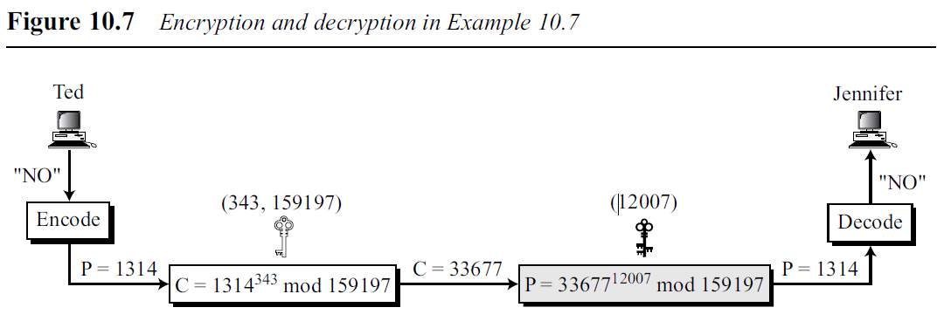
Some Trivial Examples
Example 10.7
Solution
.

Slide 31
10.3 RABIN CRYPTOSYSTEM
Devised by M. Rabin.
Is a variation of the RSA cryptosystem.
RSA is based on the exponentiation congruence; Rabin is based on quadratic congruence.
Rabin cryptosystem can be thought of as an RSA cryptosystem in which the value of e and d are fixed; e = 2 and d = 1/2.
The encryption is C ≡ P² (mod n)
The decryption is P ≡ C^{1/2} (mod n).
.

Slide 32
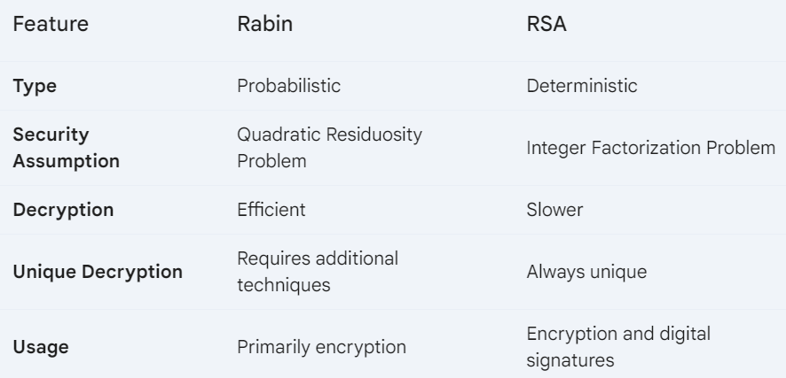
10.3 RABIN CRYPTOSYSTEM
public key in the Rabin cryptosystem is n
private key is the tuple (p, q).
.

Slide 33
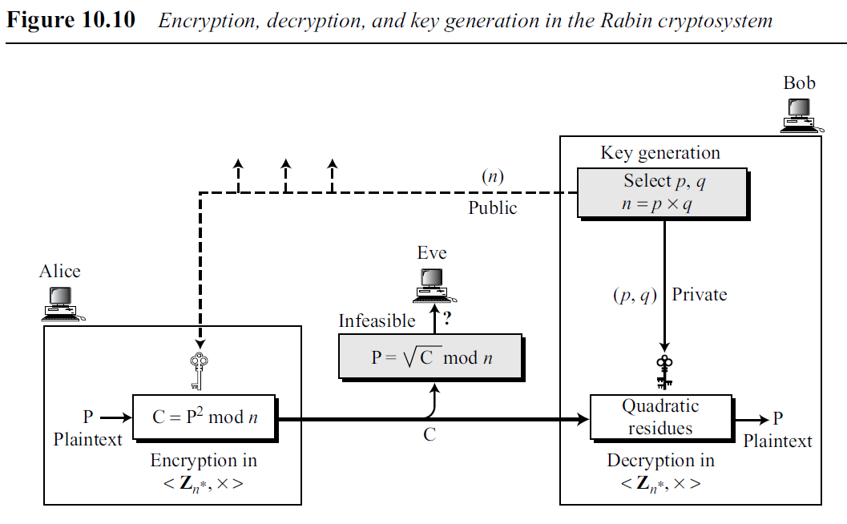
10.3 RABIN CRYPTOSYSTEM
.

Slide 34
10.3 RABIN CRYPTOSYSTEM
If Bob is using RSA, he can keep d and n and discard p, q, and φ(n) after key generation.
If Bob is using Rabin cryptosystem, he needs to keep p and q.
.

Slide 35
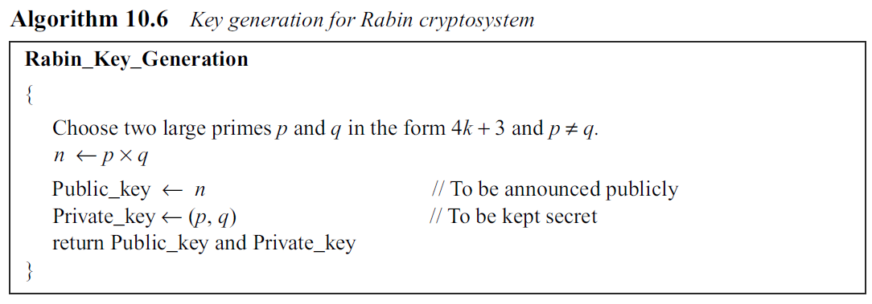
10.3 RABIN CRYPTOSYSTEM
Key generation, encryption, and decryption are.
Key Generation
.

Slide 36
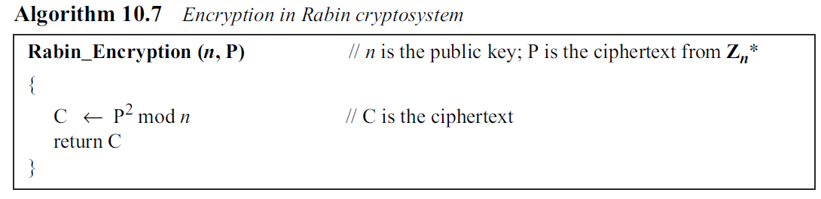
10.3 RABIN CRYPTOSYSTEM
Encryption
Encryption in the Rabin cryptosystem is very simple. The operation needs only one multiplication, which can be done quickly. This is beneficial when resources are limited.
For example, smart cards have limited memory and need to use short CPU time.
.

Slide 37
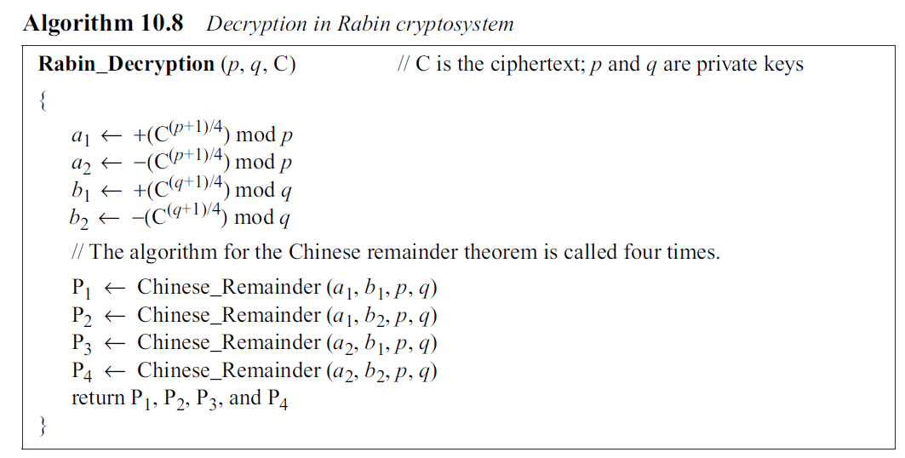
10.3 RABIN CRYPTOSYSTEM
Decryption
.

Slide 38
10.3 RABIN CRYPTOSYSTEM
Decryption
.

Slide 39
10.3 RABIN CRYPTOSYSTEM
The decryption has four answers.
It is up to the receiver of the message to choose one of the four as the final answer.
However, in many situations, the receiver can easily pick up the right answer.
Selecting the correct plaintext in Rabin decryption is a challenging problem.
Meta Data
File format
Checksum
Contextual Clues
Language analysis (Based on specific use of language)
Semantic analysis (Based on meaning or structure)
.

Slide 40
10.3 RABIN CRYPTOSYSTEM
Example
Bob selects p = 23 and q = 7. Note that both are congruent to 3 mod 4.
2. Bob calculates n = p × q = 161.
3. Bob announces n publicly; he keeps p and q private.
4. Alice wants to send the plaintext P = 24. Note that 161 and 24 are relatively prime; 24 is in Z₁₆₁*.
She calculates C = 24² = 93 mod 161, and sends the ciphertext 93 to Bob.
.

Slide 41
10.3 RABIN CRYPTOSYSTEM
5. Bob receives 93 and calculates four values:
a. a1 = +(93^{(23+1)/4}) mod 23 = 1 mod 23
b. a2 = −(93^{(23+1)/4}) mod 23 = 22 mod 23
c. b1 = +(93^{(7+1)/4}) mod 7 = 4 mod 7
d. b2 = −(93^{(7+1)/4}) mod 7 = 3 mod 7
.

Slide 42
10.3 RABIN CRYPTOSYSTEM
6. Bob takes four possible answers, (a1, b1), (a1, b2), (a2, b1), and (a2, b2), and uses the Chinese Remainder Theorem (CRT) to find four possible plaintexts: 116, 24, 137, and 45 (all of them relatively prime to 161).
Note that only the second answer is Alice’s plaintext. Bob needs to make a decision based on the situation. Note also that all four of these answers, when squared modulo n, give the ciphertext 93 sent by Alice.
.

Slide 43
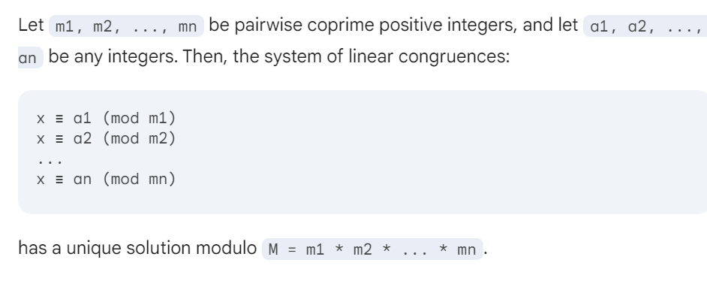
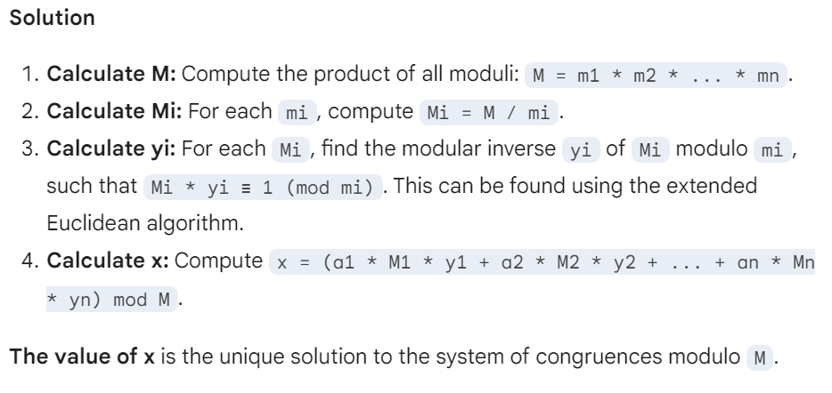
CRT
.

Slide 44
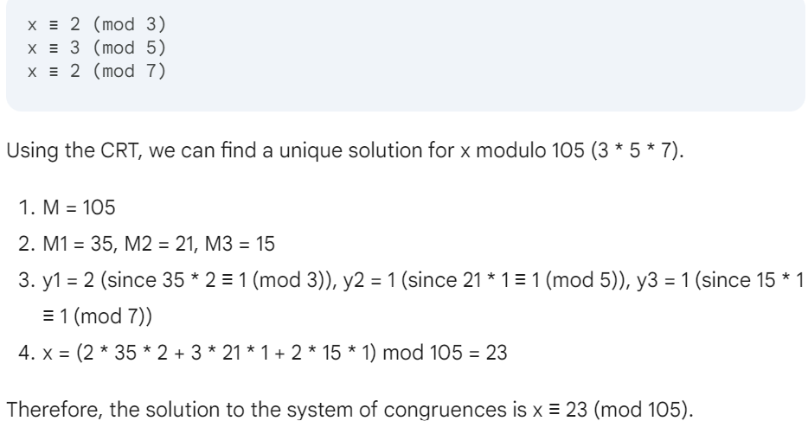
RABIN -- CRT
.

Slide 45
Security of the Rabin System
The Rabin system is secure as long as p and q are large numbers.
The complexity of the Rabin system is at the same level as factoring a large number n into its two prime factors p and q.
In other words, the Rabin system is as secure as RSA.
.

